Slide 1
DATA LAKES
Home for Unstructured Data and Unlimited Insights

Slide 2


MEET THE TEAM!
Ajinkya Bhavik Sravanthi Prattipati

Slide 3
1.
WHAT IS A DATA LAKE?

Slide 4
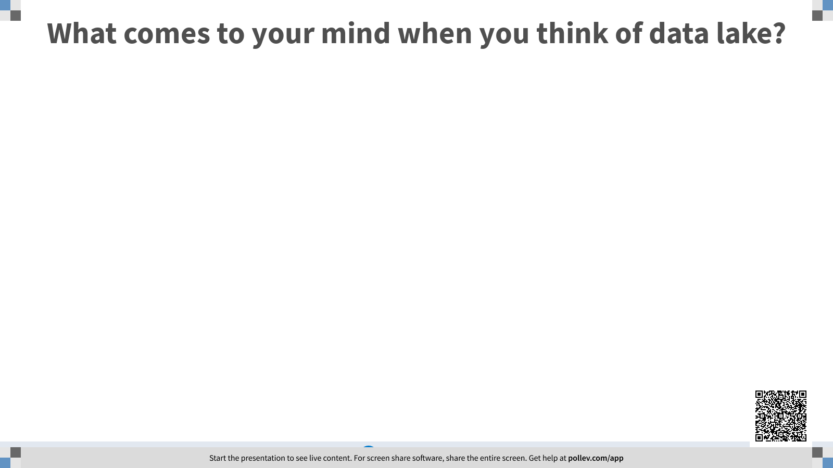

Slide 5

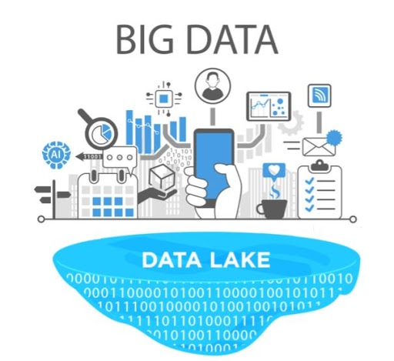
Notes:
Data Lake is one place to put all the data enterprises may want to use, including structured and unstructured data.
The idea that data lake and Hadoop are interchangeable is a frequent misconception fueled by the prevalence of data lakes that are built on Hadoop clusters. However, while a Hadoop data lake is the most common form, data lakes can also be built using NoSQL databases or a combination of technologies, including Hadoop, NoSQL systems, data warehouses and other repositories.

Slide 6
2.
HOW DO DATA LAKES WORK?

Slide 7
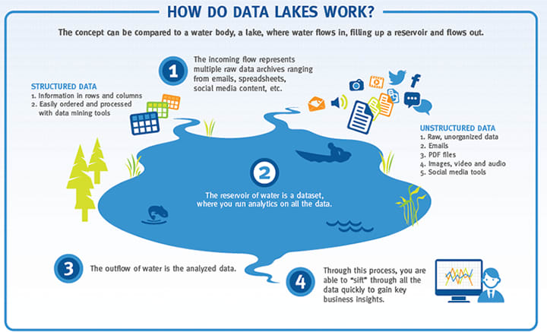
Notes:
Just like its title, data lake can be compared to a water body. The concept can be compared to a water system where the water flows in , fills up a reservoir and then the water flows out. The incoming flow of water represents multiple raw data archives which can be in different formats. The data can be unstructured ranging from an email, pdf file, images, audio, social media content, spreadsheet, video, etc. The reservoir then gets filled with the data which makes it a dataset where one can run analytics on all the data. The outflow of the water can be referenced to the analyzed data. Then through this process, one will be able to gain key business insights.

Slide 8
3.
WHY USE DATA LAKES?

Slide 9
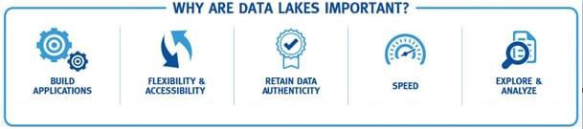
Notes:
There are several benefits to using Data Lakes. Data Lakes give an opportunity for companies to build applications, provide flexibility and accessibility, retain data authenticity, provide speed , and give an ability to explore and analyze massive data. Data Lakes serve as the backbone for applications that can be used to get the data and the development of the data-driven applications that the company really needs. Data Lakes are very flexible since they will take the data in any format which gives the company access to analyze data which they were not able to analyze before. Clean and structured data can be desirable, but data lakes let the company maintain the authenticity of the data that is used for companies to make key decisions. Despite giving unlimited opportunities for the data to be analyzed, the data lakes have the ability to sift through the immense quantities of data quickly. Data Lakes help reveal complex business issues and build predictive models to address the issues that the company might be facing.

Slide 10
4.
WHO USES DATA LAKES?

Slide 11
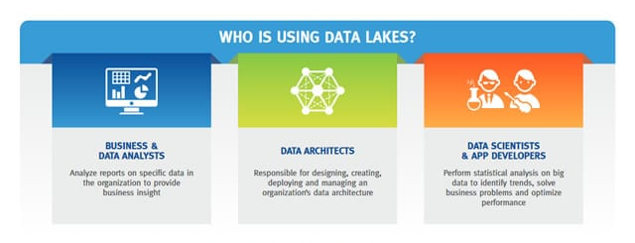
Notes:
> Firstly, business and data analysts analyze the reports on a specific data to provide the organizations insights which were gained from the data. > Data Architects are relevant to manage data lakes as they are ones who are responsible for everything from “designing, creating, deploying, and managing an organization's data architecture” . > Data scientists and app developers use the data lakes as well to perform statistical analysis on big data so they can identify trends, solve business problems, which can ultimately optimize the performance of the company. (data scientists use programming languages such as Python and R, whereas data analysts may use SQL or excel to query, clean, or make sense of their data.)

Slide 12
5.
The Origin and the Evolution of Data Lakes

Slide 13
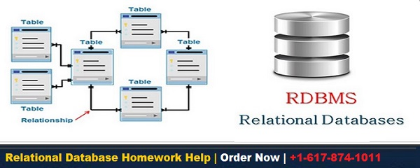
Notes:
When companies started to realize the need for managing data, they used a relational database which is able to collect, store, and analyze data. Relational databases gave companies an opportunity to store highly structured data using Structured Query Language (SQL). Relational databases or also called as Relational Database Management Systems (RDBMes) addressed companies needs as the data used to be small, structures, and simple (“History and Evolution of Data Lakes,” 2020). If companies deal with data which is relatively structured and small, relational databases would be a good choice for companies.

Slide 14
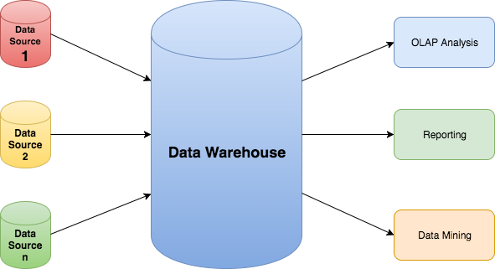
Notes:
As the dot com boom happened and the use of the internet started to rise, the companies are receiving data in all formats and in unimaginable quantities where the relational database is not addressing their needs. Companies in the industry combatted this by building multiple databases. However this led to massive amounts of data which was split into disorganized data bases
Data warehouses, just like what the name suggests, emerged to “unite companies’ structured data under one roof” . Data warehouses’ purpose is to bring a company's sets of relational databases under one roof with a mission to unite the disconnected database across the firm. However, data warehouses were not able to store the raw and unstructured data. It was expensive to deal with its hardware and software and faced trouble in scaling due to limited storage and compute power.

Slide 15
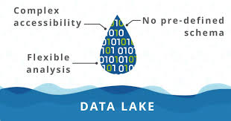
Notes:
Early 2000’s gave birth to big data which has tested the organization's ability to take in the massive and different forms of data and to be able to get the insightful results. Organizations need a way to make use of unstructured data to not miss out on the key insights. Hadoop rose as an open source distributed data processing technology.
Since the companies have the capability to analyze the raw data, this set up the stage for the modern data lake. Although many data lake architectures have changed the paths from Hadoop to running Spark in the cloud, many people associate the term “data lake” with Hadoop since it was the first framework which gave birth to the concept of data lake.

Slide 16
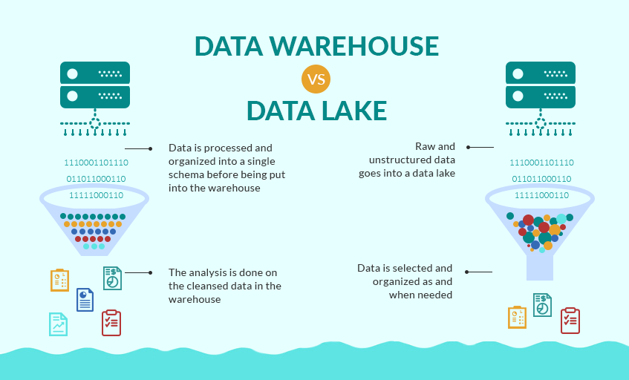

Slide 17
6.
Data Lakes VS Data Swamps
Notes:
Okay Hello everyone since we all now know about the difference between data warehouses and data lakes we now look at what an data swamp exactly is and what differentiates them from the data lakes.

Slide 18
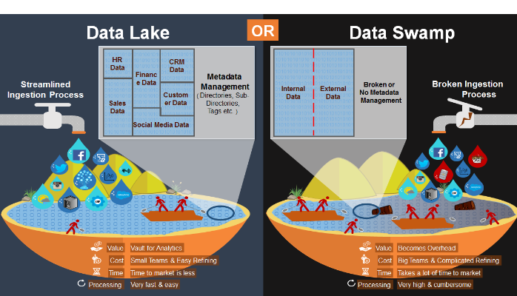
Notes:
Companies collecting huge amounts of data, storing it may risk the creation of dataswamps. Data Swamps are highly disorganized and hampers the basic tasks of retrieving and utilization of data effectively. A data lake on the other hand is a data repository which is highly organized and helps in effectively retrieving and utilizing the same data. data lakes work as a single point scalable storage repository which holds data in its native format (Matthews, 2020).
There are multiple differences between a data Lake and swamp
Ingestion process
No Metdata tags as a tiered stucture
Time to market and processing

Slide 19
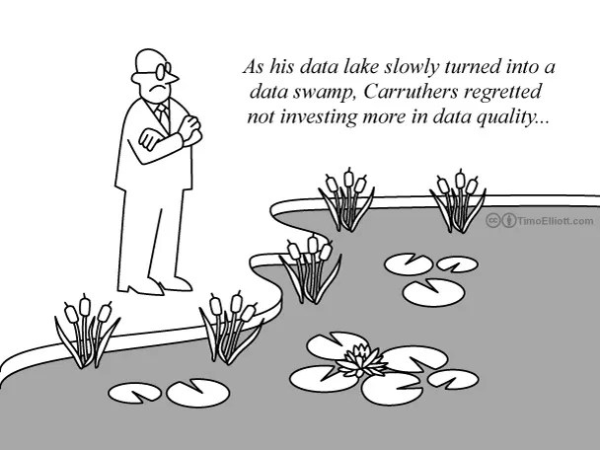
Factors which turn a data lake into a data swamp:
Lack of Metadata
Irrelevant Data
No Data Control or Data Governance
No Automated Process
Data Cleaning Strategy / Dirty Data
Notes:
Metadata helps in identifying other data while it acting as a tag so a lack of metadata is one of the fastest way to turn a data lake into a data swamp.
since it becomes relatively easier to collect data companies may end up not putting up a parameter about the kind of data they would want to gather and why. Irrelevant Data could be gathered which may make the storage option flooded with information which may never be needed.
Data Governance - This helps in managing a high level of data quality through the entire cycle. Helps to avoid wrong data which may upon auditing lead to illegal regulatory data
No automated process - Helps in standardizing data usage practices across platforms and process all raw data in the same ways. Crucial for data lakes
Data Cleaning - problem is that data lakes can deteriorate and become data swamps unless enterprises make and stick to plans for regularly cleaning their data. If the data has errors, or there are duplicates in the database, it’ll be difficult for company leaders or stakeholders to trust the information

Slide 20
7.
Types of Data Lakes [Data Lake Providers]

Slide 21
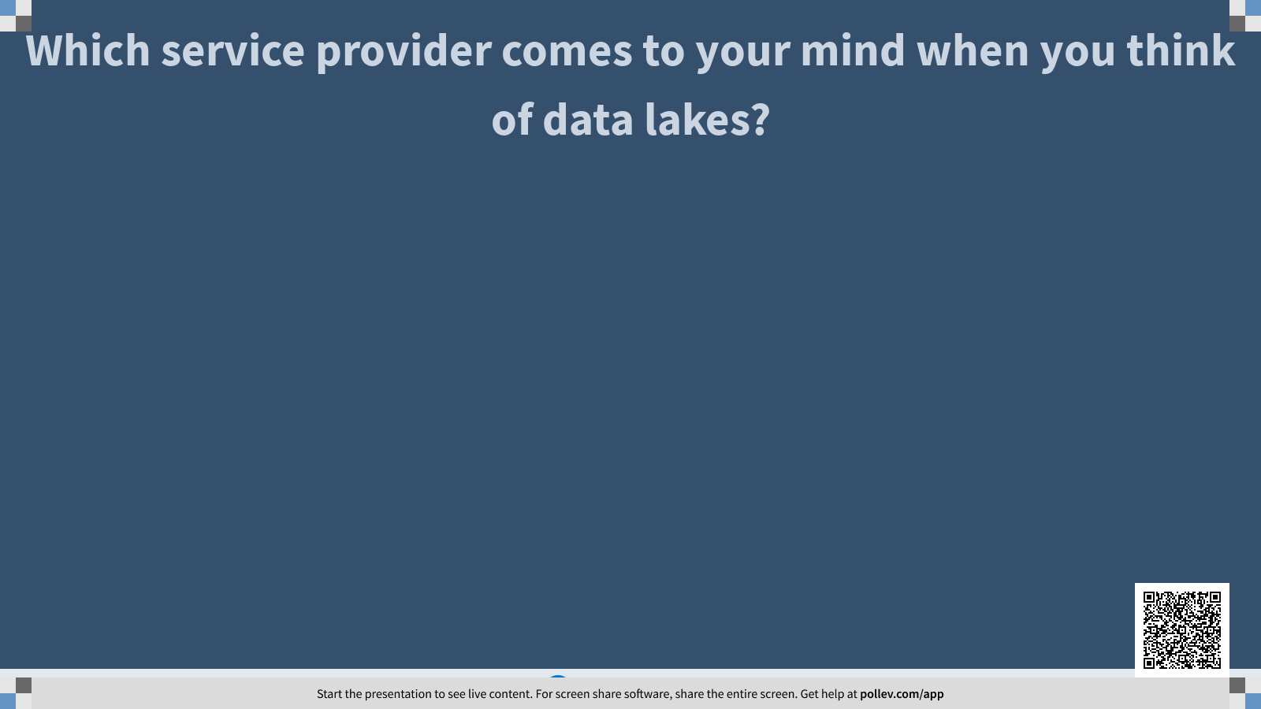

Slide 22

Netflix, Facebook, Twitch & Linkedin
Fast insights and answers for all users
Easier to Build & Facilitates faster analysis of Data
Broad and Comprehensive of tools - High Scalability.
Cost Effective
Provide Secure architecture for analytics
Use Services and tools like Amazon Mackie, Inspector
Notes:
AWS provides Data Lake services for many major organisations such as Netflix, Twitch, Linkedin and Facebook. AWS Data Lakes are known to help find the fastest insights and answers from the data to all their users. Some of the AWS Data Lake perks are that AWS data lakes are easiest to build as well as analyze. They provide a very broad, open and comprehensive array of analytical tools and technologies which puts AWS with the highest scalability. AWS data lakes are cost effective and provide a secure architecture for analytics. These lakes also provide fine grained access and control of data. They use features like Amazon Macie which helps find sensitive data or wrongly stored data as well as Amazon Inspector to spot errors in configuration to avoid data breaches

Slide 23
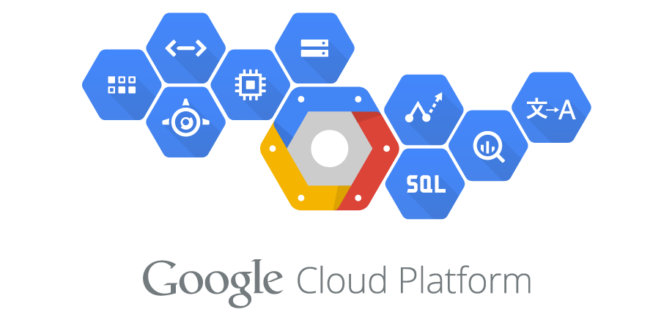
Google Cloud Storage which acts as storage spaces for Data Lakes.
Unstructured Data - Cloud SQL
Structured Data - Bigquery
Store Save and process all Types and Sizes of Data.
Multiple Tools - Different Phases - Data Processing
Notes:
Google being one of the last few entering the cloud and data storage domain did things a lot differently than conventional data lake service providers. The main component of GCP’s data lake is its Google Cloud Storage which acts as storage spaces for Data Lakes. In a Data Lake, GCP is used for unstructured data using CloudSQL, while Big Query is used for structured data. One can store and save and process all types and all sizes of data in this Data Lake. There are multiple tools for all phases of data processing in data lakes. Those are Cloud Transfer Service, BigQuery API [Ingestion], Cloud Storage, Bigtable [Store], Dataprep, Data flow [Process], Big Query [Analyse], Data Studio [Reporting] (Data Lake Modernization, 2020).

Slide 24
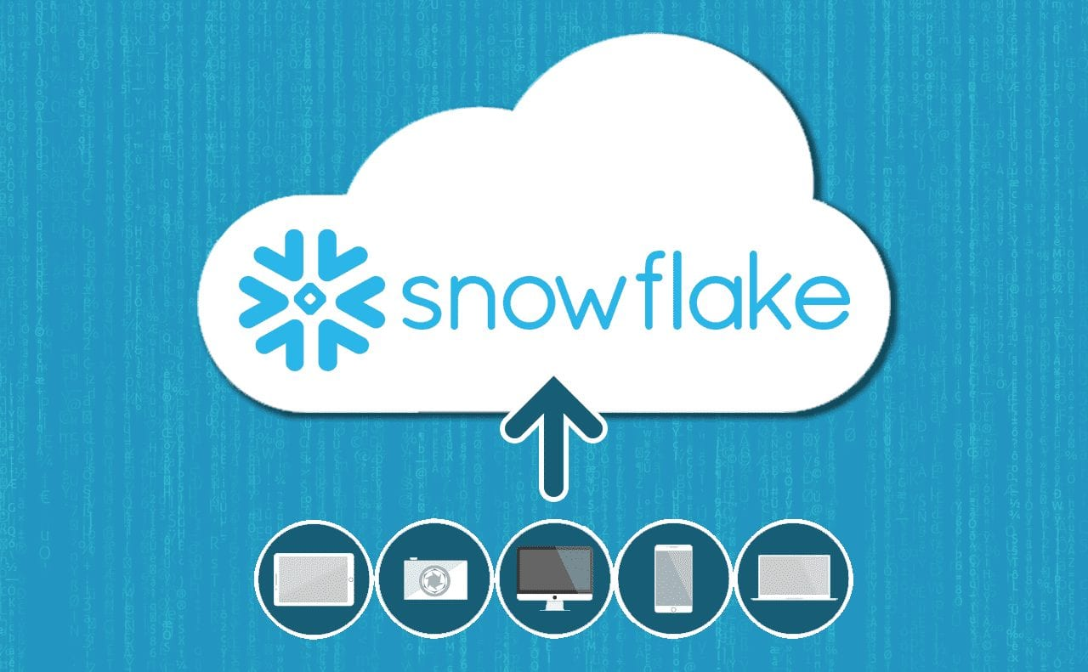
Eliminating Data Silos
Multiple Dataset Workload - Single platform
Governed and Safe Access to Data along multiple levels
Consolidated Data and Fast scalable analytics
Simple and Cost effective
Granular level access control for precise accessibility
Notes:
Snowflake’s philosophy centers on eliminating data silos and running multiple sets of workload on a single platform. It acts as a governed and safe access to all data along multiple levels and types into one single platform. Some of the key features of using snowflakes data lakes are that they provide consolidated data, fast scalable analytics on that data. The data lake is also very simple and cost effective while at the same time pretty secured and governed. Snowflake provides exceptional fast query performance, integrated and extensible data pipelines and secure governed collaboration with users. It transforms data efficiently using ANSI SQL. Granular level access control for precise accessibility is something which renders snowflake an advantage in certain sectors as well (Snowflake, 2020).

Slide 25
8.
Where are Data Lakes used? [Success Stories]
Notes:
The deluge of data in all its forms from different sources hold valuable insights for an organisation. Usage of Data Lakes in organisations have brought about a lot of change and flexibility in the data analysis within the organisations. Below we discuss some of the examples of how many organisations shifted their systems into using data lakes and the transformations brought about within these organisations.

Slide 26

American Internet retailer based in the Dallas suburb of Carrollton, Texas
Cloud Native Data Lake as replacement for their legacy data warehouse system
Ability to garner insights into operations by all of Users.
Minimal Architectural Maintenance.
Response Time for changing tables
Operation costs fallen down by 90%
Serverless infrastructure gaining access
Facilitate experimentation with newer technologies
Notes:
So now let's talk about Woot is an American Internet retailer based in the Dallas suburb of Carrollton, Texas. Their major concern was to replace their legacy data warehouse system which was based on RDBMS into Cloud Native Data Lake as a server less architecture solved multiple of their data access and quality issues.
Ability to garner insights into operations by all of Users. [Identifying and fulfilling customer needs]
Minimal Architectural Maintenance.
Response Time for changing tables
data lakes were introduced architecturally and in an operational context as well. A shared responsibility was introduced for data ingestion and serverless model was preferred over traditional RDBM models. This shifted the responsibility of the data ingestion team and customized pipelines towards services to push their data ahead. This led to the development team having control over their services data. Setting up this data lakes thus increased accessibility which was brought about by using AWS technologies like Amazon Kinesis Data Firehose for data ingestion, Amazon S3 for data storage, AWS Lambda and AWS Glue for data processing, AWS Data Migration Service (AWS DMS) and AWS Glue for data migration, AWS Glue for orchestration and metadata management & Amazon Athena and Amazon QuickSight for querying and data visualization. (“AWS Big Data Blog”, 2019) Customer Services also had levelled up since users now didn't have to download sql client, request user name password and learn sql to get data out. Now they could just directly user queries with Athena or even use Amazon Quicksight for accounts managed through pre existing directories
Operation costs fallen down by 90%
Serverless infrastructure gaining access
Facilitate experimentation with newer technologies

Slide 27

Healthcare sector - outdated data ingestion, aggregation and analysis methods.
Developed data activation platform [Big Data Platform]
Development load from Google Cloud to Amazon Web Services
Leveraged EC2 servers [Elastic Cloud Compute]
Huge data, low maintenance costs, cost-effectiveness, ease of scalability
70%less cost and almost half processing time
EC2 also led to reduction of Data Security concerns
Notes:
Healthcare sector has been dealing with a lot of outdated data ingestion, aggregation and analysis methods. Innovacer decided to develop a data activation platform [Big Data Platform] based on the need of healthcare organisations to make powerful, data driven decisions. It leveraged EC2 servers [Elastic Cloud Compute] for hosting its web-based applications and data warehouses. The deployment provided developers in the organisation with better accessibility, more fine grained control and improved performances.

Slide 28
9.
Data Lakes Future/Vision
Notes:
Data Lake a few years ago seemed like a dream, but now every major organisation has been working and implementing data lakes into their reality. On this journey of connecting enterprise data together, access to organisational data from a secure, well managed and controlled single point will soon become a necessity. This would lead to all major organisations opting for data solutions like Data Lakes which contain all organizational level data together and would integrate seamlessly with Data Tools and technologies as well

Slide 29
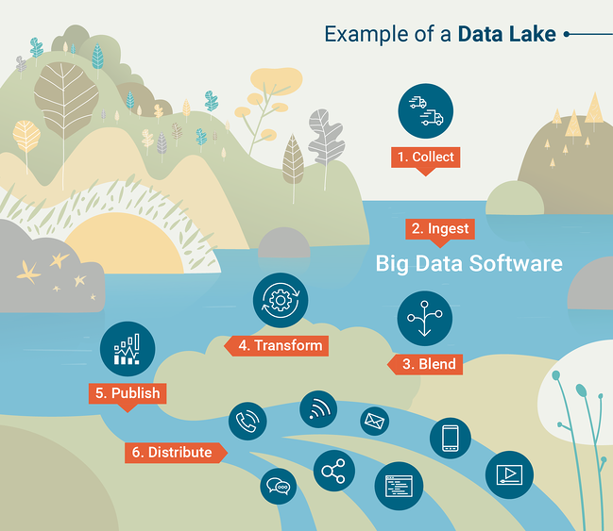
FUTURE OF DATA LAKES
Access to organisational data from a secure, well managed and controlled single point will soon become a necessity
Emerging as a practical approach to finding solutions for increased data and analytical data capabilities
Adoption of IOT will help in Data Proliferation
More focus on Data Driven decision making
Leverage the latest AI and ML technologies
Place your screenshot here
Notes:
Data Lakes offer better analytical capabilities for organisations wrestling with management, storage and processing of ever growing data volume. The speed of a data retrieval in data lakes is considerably higher than contemporary data warehouses thus major operations like necessary extraction/transformation/load (ETL), data cleaning, and exploration will be done on Data Lakes. The adoptions of IOT in many work areas will also enforce the usage of Data lakes to fulfil the purpose of Data Proliferation as well (Future of Data Lakes, 2019).
Businesses lately are more focused on data driven insights based decision making. Digitalization of business gives rise to an enormous quantity of data. Data Lakes will thus overtime emerge as a practical approach to finding solutions for increasing data as organisations will need advanced predictive and analytical data capabilities. The processing of data on cloud also acts as a catalyst to the growth of data lakes in future markets. Further work on using Data Lakes in organisations if focused towards Artificial Intelligence will help in achieving better business outcomes (Future of Data Lakes, 2019).
Organisations are basically looking for a simplistic and efficient way to facilitate the benefits of data lakes. Their upcoming requirement would be of an approach which utilizes a data approach without having to replace the existing system setup or retrain the whole staff. The system should be able to leverage the latest AI and ML technologies and be able to stay up and running for hours and days rather than weeks and months (Future of Data Lakes, 2019).

Slide 30

THANKS!
Any questions?

Slide 31
Works Cited
Data Lake. (2015). Retrieved December 01, 2020, from https://searchaws.techtarget.com/definition/data-lake
Data Lakes and the Data Lake Market: the What, Why and How. (2020). Retrieved December 01, 2020, from https://www.i-scoop.eu/big-data-action-value-context/data-lakes/
Data lakes on AWS. Retrieved December 01, 2020, from https://aws.amazon.com/solutions/implementations/data-lake-solution/#:~:text=AWS%20offers%20a%20data%20lake,or%20with%20other%20external%20users.

Slide 32
Works Cited
Data Lakes vs Data Warehouses - Snowflake (2020). Retrieved December 01, 2020, from
https://www.snowflake.com/trending/data-lake-vs-data-warehouse
The Future of Data Lakes AI Martin. Mar 13, 2019. Retrieved December 01,2020, from
https://medium.com/ibm-data-ai/the-future-of-data-lakes-33dada28fed6
History and Evolution of Data Lakes. (2020). Retrieved December 01, 2020, from https://databricks.com/discover/data-lakes/history

Slide 33
Works Cited
How Innovaccer is Helping Healthcare Organizations Activate Their Healthcare Data. 6 August 2019 Retrieved December 02,2020 from https://aws.amazon.com/blogs/startups/how-innovaccer-helps-organizations-activate-health-data/
Matthews, K. (2019). The difference between a data swamp and a data lake? Retrieved December 01, 2020, from https://www.information-age.com/data-swamp-data-lake-123481597/

Slide 34
Works Cited
Our data lake story: How Woot.com built a serverless data lake on AWS. 22 January 2019 Retrieved December 01, 2020, from https://aws.amazon.com/blogs/big-data/our-data-lake-story-how-woot-com-built-a-serverless-data-lake-on-aws/
Petrov, C. (2020, September 10). 25+ Impressive Big Data Statistics for 2020. Retrieved December 01, 2020, from https://techjury.net/blog/big-data-statistics/#gref

Slide 35

Notes:
https://create.kahoot.it/kahoots/my-kahoots

